Slide 1



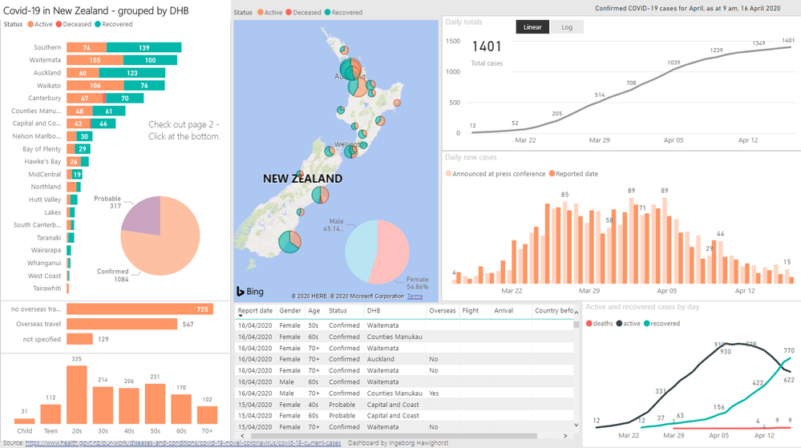
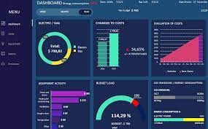
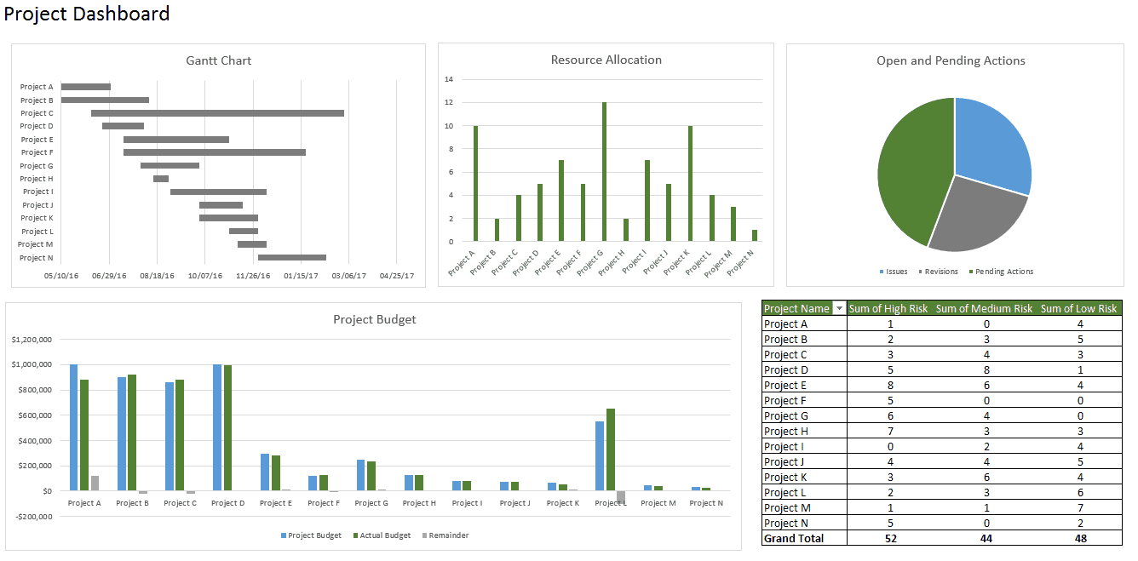
INT 217
INTRODUCTION TO DATA MANAGEMENT
COVID-19 DASHBOARD
SUBMITTED BY :
MALVIKA KAUSHAL
11901443

Slide 2
Country-wise dataset
Dataset is based on Covid-19 statistics country-wise.
It is taken from kaggle.
It consists of 15 columns
It contains different countries names based on WHO Region

Slide 3



Covid-19 Dashboard Objectives
I took my dataset from Kaggle and following were my objectives.
Top-5 active cases
Countries with new cases
TOTAL DEATH COUNT
RECOVERED RATIO
% INCREASE LAST WEEK

Slide 4

Features used in objective-1
Pivot table with Bar Chart
Sorted from largest to smallest
Filtered for TOP-5

Slide 5
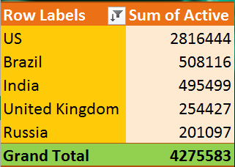
OBJECTIVE-1 : TOP 5 ACTIVE CASES

Slide 6

Features used in objective-2
Pivot table with Area Chart
Slicer is added
Slicer is connected with all charts.

Slide 7
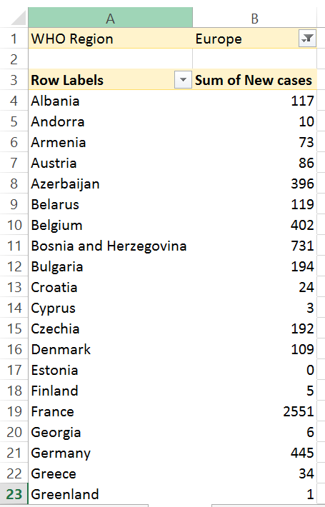
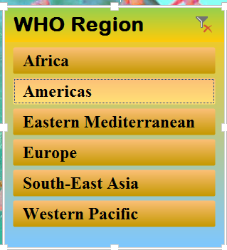
Objective-2 : countries with new cases

Slide 8

Features used in objective-3
Pivot table with Line Chart
Slicer is added
Slicer is of WHO REGION

Slide 9
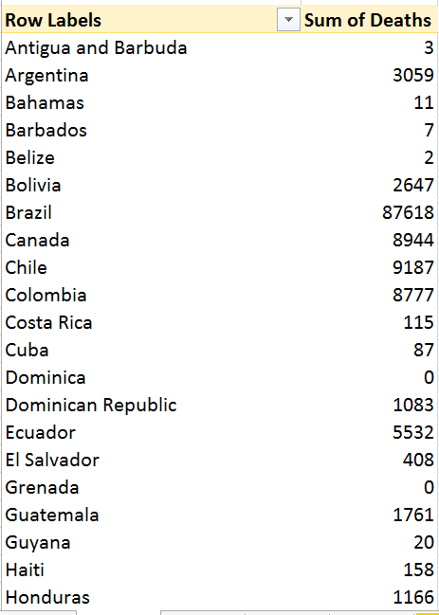
Objective-3 : total death count

Slide 10

Features used in objective-4
Pivot table with Pie Chart
Sorted from largest to smallest
Filtered for TOP-5

Slide 11
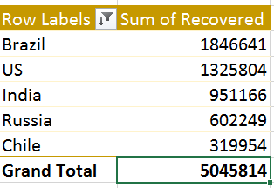
Objective-4 : Recovered ratio

Slide 12

Features used in objective-5
Pivot table with Cylindrical Chart
Sorted from largest to smallest
Filtered for TOP-3

Slide 13
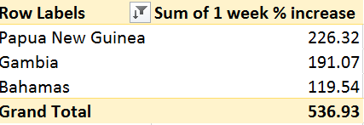
Objective-5 : % increase last week

Slide 14
Additional Add-ons
Unique countries list is added
User can select any other of his/her choice and can check the statistics of that country.
After selecting the country user can see Total cases, deaths, recovered, new cases, Death rate, Recovered rate.

Slide 15
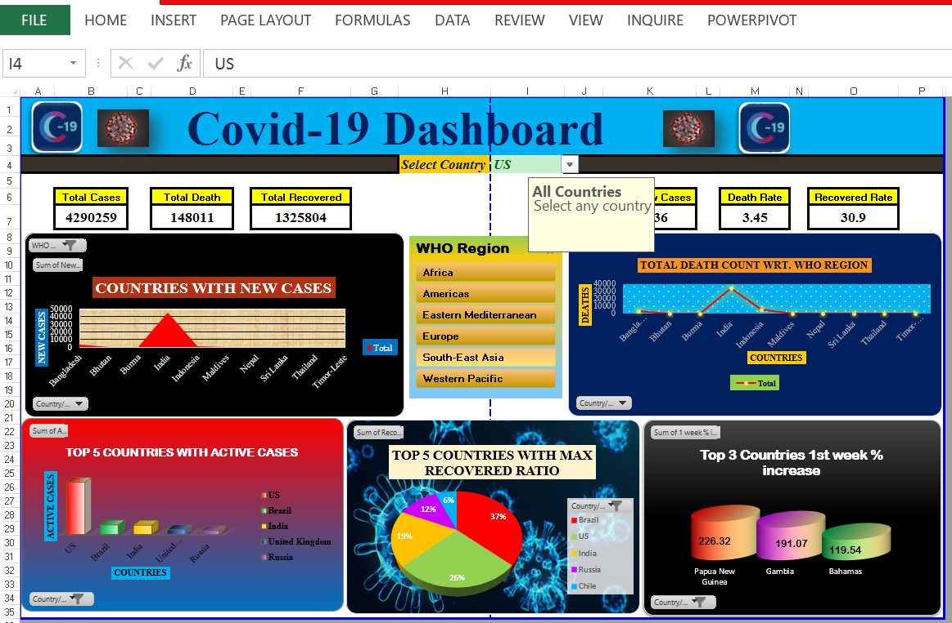
Covid-19 Dashboard

Slide 16
Importance of this Dashboard
Since COVID has spread worldwide, leading to an ongoing pandemic. So picking up latest topic can create awareness among people.
Also it’s a user friendly dashboard where user have to select any country and they can check the stats.
COVID-19 dashboards are helping people make sense of the pandemic.
The dashboard has a clean and modern interface and several data visualization tools to better grasp the current status of COVID-19 as the situation unfolds.
The dashboard has slicer based on WHO REGION, so user can select the region and check the countries situation in that region.
People can get idea about Top-5 and Top-3 countries based on recovery rate and percentage increase last week.

Slide 17
references
https://www.kaggle.com/
https://youtu.be/Zes951J1llE
https://www.kaggle.com/imdevskp/corona-virus-report?select=country_wise_latest.csv
https://en.wikipedia.org/wiki/COVID-19

Slide 18

Thank You!!

